Slide 1


RDBES overview
WKRDB-POP
Henrik Kjems-Nielsen
ICES Secretariat

Slide 2
InterCatch (IC), Regional DB (RDB) and Regional DB and Estimation System (RDBES)
Data export for Improving Stock Assessment/Advise
Level of processed data/ completeness of stock data
Data export for ICES Stock Assessment/ Advise
Data export for RCG Analyses
Stock data at international level. Numbers and mean weight at age. No data missing
IC
Species data at national level. Sample data raised. Distributions missing for unsampled strata
RDB
RDBES
Regional DB and Estimation System (Statistical Estimations)
Species data. Landings, effort and individual fish sample data
Import data
RDB Regional DataBase raising/estimation
Import data
IC InterCatch raising/estimation
Steps in raising/ estimation
RDBES Regional DB and Estimation System (Statistical)

Slide 3
Reasons why we are behind
The reasons why we are behind the original plan
It is much more difficult to define the data model that first expected, because of the complexity of all the different sampling methods going on in all the countries for all the different species
When the User Requirement Specifications are not delivered it is difficult to develop the system and it takes longer time to do the parts.
Originally we did not expect the system to be so complex and dynamic, the existing RDB is 5 table and one hierarchy, the RDBES has 15 tables and 32 hierarchies

Slide 4
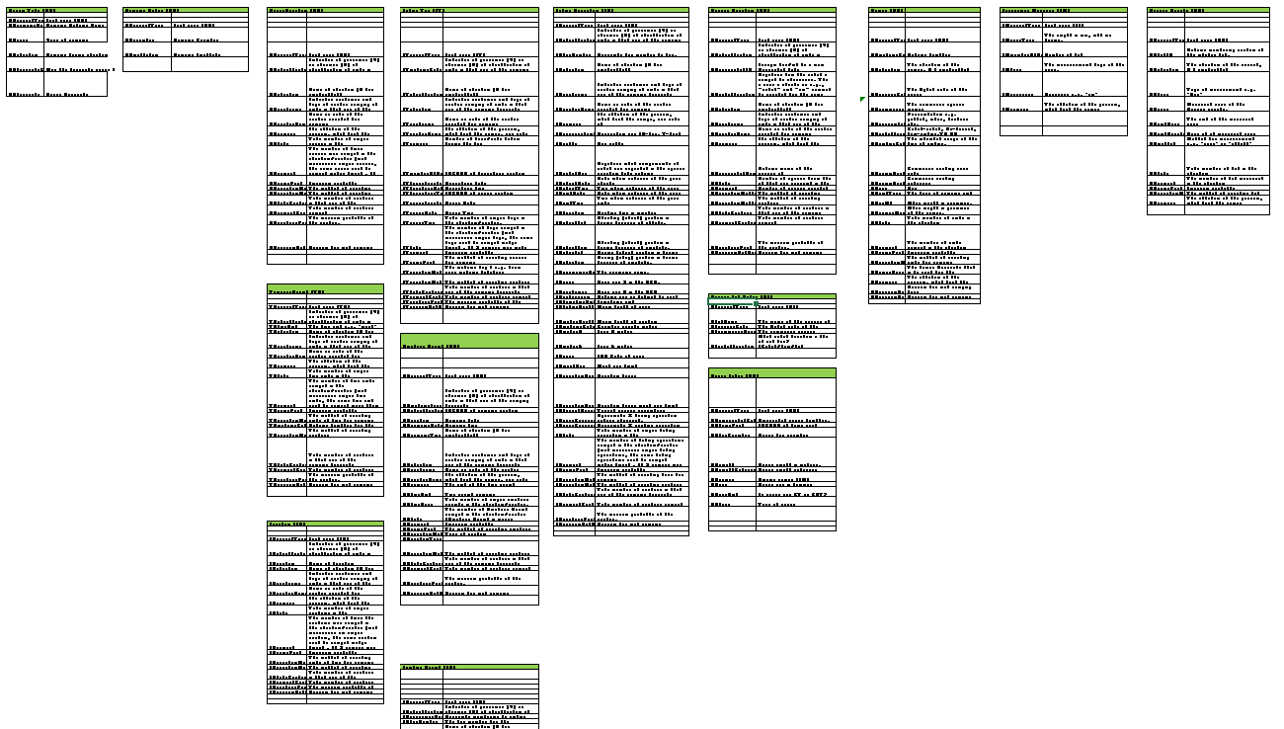
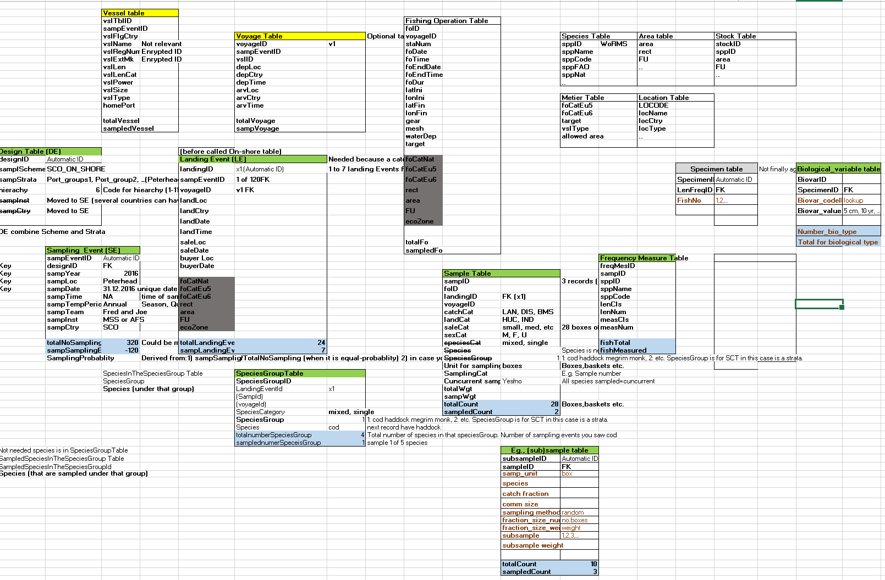
RDBES covers all sampling types
The existing RDB contains 5 tables for sampling: Trip, Individual samples, Haul, Species list and Length data
RDBES data model May 2018
This model is the first that covers all countries and potentially all species.
15 tables, combined in 32 different hierarchies
RDBES data model May 2017

Slide 5
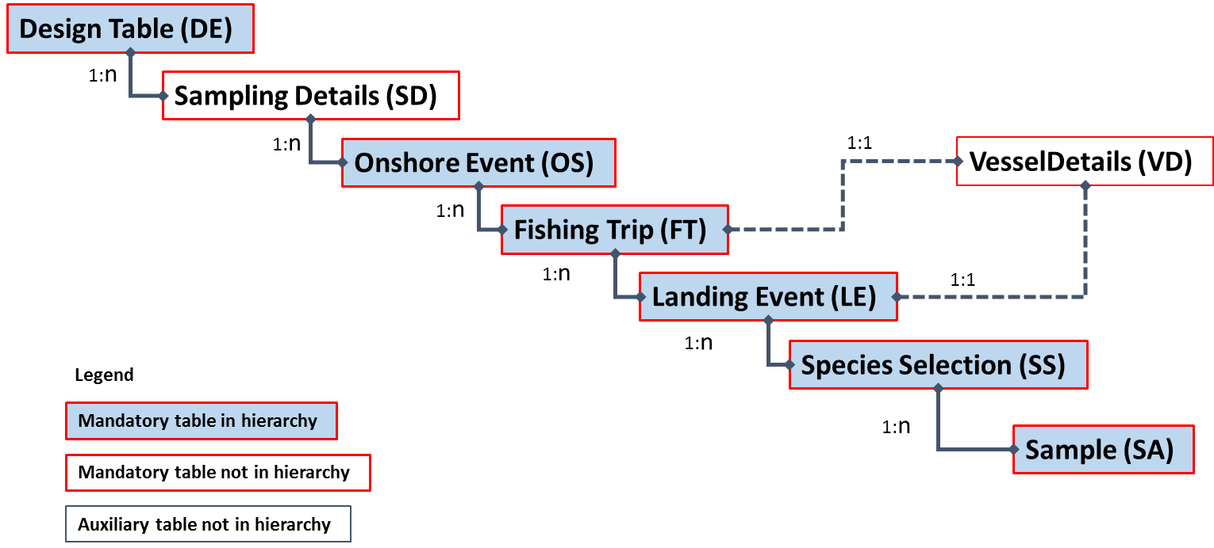
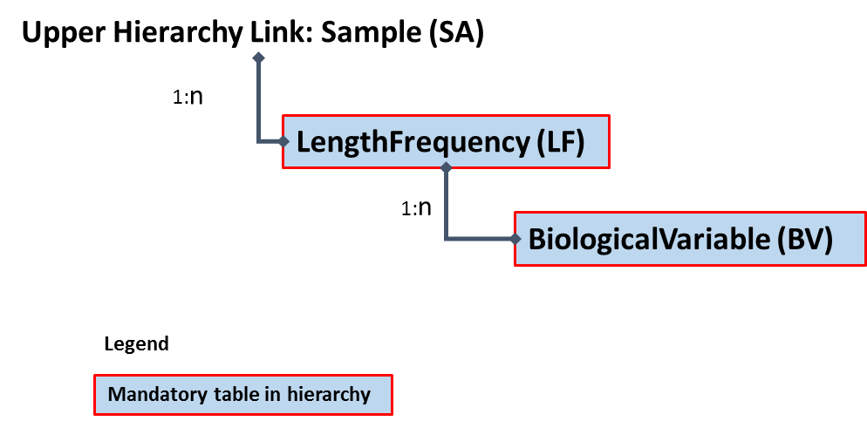
RDBES table relations for 1 of the 32 sampling structures/hierarchies

Slide 6
The active Core Group of the RDBES development support group
Kirsten Birch Håkansson, DTU Aqua, Denmark Kibi@aqua.dtu.dk
Nuno Prista, SLU Aqua, Sweden Nuno.prista@slu.se
David Currie, Marine Institute, Ireland David.Currie@Marine.ie
Edvin Fuglebakk, IMR, Norway Edvin.fuglebakk@hi.no
Twan Leijzer, WUR, Netherlands Twan.leijzer@wur.nl
Henrik Kjems-Nielsen, ICES Henrikkn@ices.dk
Now with two new members: Marta from Poland and Josefine from Denmark.
The Development Support Core Group is a subgroup of SCRDBES and in open to any participant, who want to contribute to the development and specifications of the RDBES.

Slide 7
Core Group work plan for the 3 first months
Time | Action
26th Jan. (week 4) | Finish the work on the documentation.
29th Jan. (week 5) | Circulate the documentation to rest of the Core group.
1st or 2nd Feb. (Week 5) | Core group Skype meeting discuss feedback and make decisions.
5-8th Feb. (Week 6) | Core group correct/updated minor changes.
9th Feb. (Week 6) | Send to WGCATCH ask for feedback.
12th – 23th Feb. (Week 7-8) | WGCATCH will review.
23th Feb. (Week 8) | Deadline for written feedback from WGCATCH persons. Persons can give individual feedback.
26th Feb. (week 9) | Core group deadline for reading all WGCATCH feedback.
27th or 28th Feb. (week 9) | Core group Skype meeting discuss feedback and make decisions.
28th Feb. - 2 March (week 9) | Core group update doc.
5th March (week 10) | Send to countries ask for feedback. Send to NC and ACOM members and RCG Chairs, SCRDB and Pan RCG data group (list in RCG NSEA 2017 (page 9 of the draft report).
5th – 2nd April (week 10-13) | Countries, RCG Chairs, SCRDB and Pan RCG data group will review.
2nd April (week 13) | Deadline for countries’ feedback
5th – 2nd April (week 13) | Core group reading all feedback from countries, RCG chairs, SCRDB etc.
21st or 22nd March (week 12) | Core group Skype meeting discuss feedback and make decisions. ToRs for next WK. Agree on way forward.
3th - 6th April (week 14) | WKRDB-SPEC

Slide 8
ICES Data centre need the following as soon as possible
Test data files for different hierarchies
Specifications of
User roles and security
Checks
Processing before estimations
Estimations using R
Processing of outputs and reports

Slide 9
Workshops to specify the data model in 2018
It is a difficult task to specify the new data model for the RDBES, the core group and ICES have last year had:
About 10 Internet meetings
WKRDB-MODEL January 4 days
Worked on the data model. Still to many out standings.
WKRDB-SPEC April 4 days
Intention was to write specification of the RDBES, but it was needed to finalise the data model.
WKRDB-URS October 4 days
Countries feedback on the data model. Populating the data model and document for new users. Start writing the user requirement specifications. Code lists, overwrite rules, user roles.

Slide 10
2 workshops in 2019
WKRDB-POP (co-chairs David Currie, Edvin Fuglebakk) 18th February
Population of the RDBES data model (sample data)
WKRDB-EST (co-chairs Kirsten Håkansson, Nuno Prista) October
Estimations of catch and sample data

Slide 11
Strategy RDBES diagram with statistical methods
Data flow
Regional DataBase Estimation System
National data submitters
Experts raise data
End users
Security & Logging
ICES
Assessment Expert Groups/
Advice
Input data
Common quality checks and import of national detailed catch, effort and biological data
Raising of national detailed biological data using the Statistical methods.
Documentation of data, method and version
Combine data and produce standardised data products and reports
Harmonised national landing, effort and sample data
New Format
RCM/RCG
Data and reports
Statistical methods (e.g. in R) for national raising. Version control needed inside the RDBES
STECF
Data and reports
New methods
Methods in R approved for implementation in the RDBES

Slide 12
Regional DataBase and Estimation System developments
Using the most modern client side frame work (Angular) and REST server side services programmed in MVC .NET Core. For better user experience, better response time, and reduce the data between the server and client
Implemented authentication from Angular
Implemented administrative module ready for specifications

Slide 13
Regional DataBase and Estimation System developments
Adapt the generic CSV to XML converter to the actual data model
Generic method to generate/update XSD files for all hierarchies in one go
Passed the first test of uploaded and inserted simple a test files for all hierarchy through the RDBES upload interface.

Slide 14
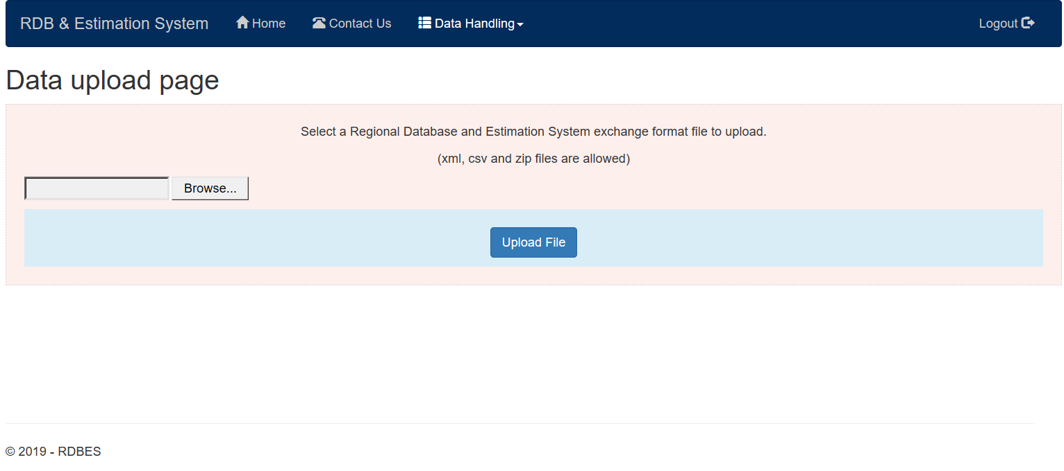
The first test version of RDBES (upload/download)
URL link: sbox.rdbes.ices.dk

Slide 15
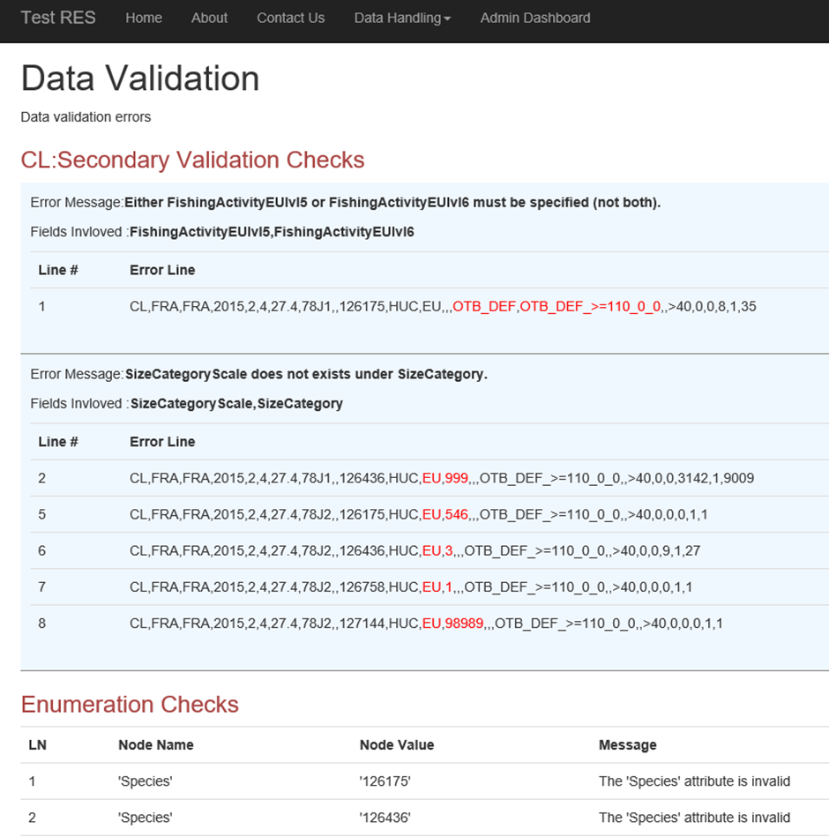
The current check feedback page
Notes:
This is just to show that we have a simple and very limited version of RDBES running.

Slide 16
Large Pelagic
RCG LP in June
Skype meetings Aug., Oct. and Nov.
During the test of the RDBES data mode with the large pelagic fisheries, it looks like there potentially is a need for some tables specifically for the large pelagic, but further analysis are needed
Funding has to be found

Slide 17
Long Distance Fisheries
Data call next year
Dead line not set
Allowed metiers in fishing grounds need to be send to ICES Sec.
We will create new areas needed for LDF. Make some sub-divisions e.g. 34.1.2.1 for the Northern part and for Madeira and 34.1.2.2 for the Southern part and for the Canary Islands.

Slide 18
Diadromous species
Discussions with the Diadromous Sub Group, DSG, at the RCG NS & EA at DTU Aqua
Chaired by co-chair Dennis Ensing from Northern Ireland (co-chairs Alan Walker
Positive towards the RDBES and will move forward in that direction

Slide 19
Recreational fisheries
WGRFS recommended to engage with the RDBES system being developed by ICES (ICES 2017)
It is needed to look more into the different options on how to include the recreational fisheries data in the RDBES. As it looks now it will probably be best to add 2 recreational fisheries tables to the RDBES and develop everything that is needed for them
Funding has to be found

Slide 20
WGBYC
Inclusion of the following variables in the FO table:
Slipping_observation (Y/N): Indicator of observation of slipping. Slipping takes place outside the fishing vessel.
Hauling_observation (Y/N): Indicator of observation of hauling. Hauling takes place between the water and the inner part of the fishing vessel.
Sorting_observation (Y/N): Indicator of observation of the sorting. Sorting happens inside the fishing vessel, on the deck or in some sort of a conveyer belt / sorting platform.
Inclusion of the following variables in the key of the SS table:
“Activity_type” (text), defined as SLIP (= SLIPPING), HAUL (= HAULING) and SORT (=”SORTING”).
“Sampling type” (integer), defined as 1 (= volume) and 2 (= visual).
Inclusion of a variable in one of the table of the lower hierarchy that records the state of the individuals (e.g., dead, alive, wounded, unknown)

Slide 21
 | RDB System | InterCatch | RDBES | ICES Secretariat | Core Group | WGCATCH/ PGDATA | Countries | WG and Benchmark | RCGs
2019 | Production Data in/out | Production Data in/out | Development Test data in/out | System development Test web between Feb-Oct. RDBES operational Dec. | Specifications WKRDB-POP Upload data WKRDB-EST. Start specifying Large Pelagic needs. | WGCATCH: Reviewing the outcome WKRDB-EST and suggest improvement. Guideline and algorithms for general estimations (ratio/statistical/ Design based). PGDATA: Describe how the RDBES fits into the QAF. | WKRDB-POP Upload data after POP. Participate and prepare for RDBES format and estimations WKRDB-EST |  | RCG chairs to request countries to participate in the WKRDB-POP. RCG support the countries to allocate sufficient time for these WKs.
2020 | Production Data in/out | Production Data in/out | Test by selected stocks | Large Pelagic development (funding needed). | WKRDB-POP (Jan-Feb) target selected stocks. WKRDB-EST (incl. imputation) Estimations for selected stocks |  | Data call. Upload data for selected stocks after WG WKRDB-POP WKRDB-EST | Upload data. WG estimations. Trans Data compilation WK. Laurent/Core Group will help selected WG with selected stock (10-20)
2021 | Production Data in/out | Production Data in/out | Test by all stocks |  | WKRDB-POP (Jan-Feb) target all stocks. WKRDB-EST Estimations finalised
2022 | Stay alive Data out | Stay alive Data out | Data call for 2021 data
2023 | Stay alive Data out | Stay alive Data out | Data call for 2022 and all year
2024 | Terminated | Terminated

Slide 22
Challenges using the RDBES
The stock coordinators will have to work closer and more direct with data and R to estimate data – not like in InterCatch. Any suggestions on how this graduate shift should happen?
Not every stock need to use statistical sampling and estimation/raising, but R scripts need to be written/copied and adjusted if needed for any used estimations statistical or ratio-estimated and combination of the stock data. The idea is that once a R scripts for one type of sampling is written, then it can be reused for similar types of sampling data/stocks
Stock assessors and the advice than can use the coefficient of variance, CV, calculated for the statistical data (and ratio-estimated but that is hard and not done)

Slide 23
Conclusion
The RDBES is being specified by the Core Group, countries have given feedback 3 times during 2018, which is incorporated
All countries support the data model
The RDBES web system is developed by ICES Secretariat
Funding is missing from Oct. 2019 for RDBES web system development
Countries should upload data for select stocks in 2020
WGs should start to prepare to use the RDBES
2 WK in 2019: WKRDB-POP 18 Feb. and WKRDB-EST Oct.

